Slide 1

Not So Dumb People
CONNECT

Slide 2
AGENDA
01
02
The Problem
Overview
03
04
05
AIgorithm Approach and Novelty of the Solution
Application Demo
Value Proposition & Technologies Used

Slide 3

The Problem
The need for Women In Tech to fit-in and have the right guidance and for the communities who support them to have a freely accessible platform to pair the Mentors and Mentees automatically and make the process more communication-oriented.

Slide 4
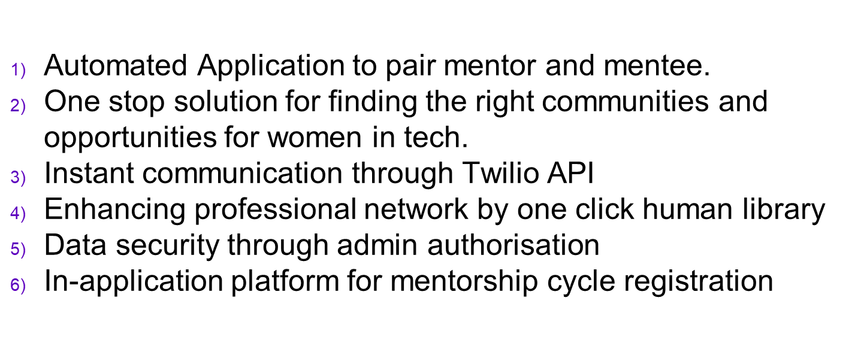
Overview

Slide 5

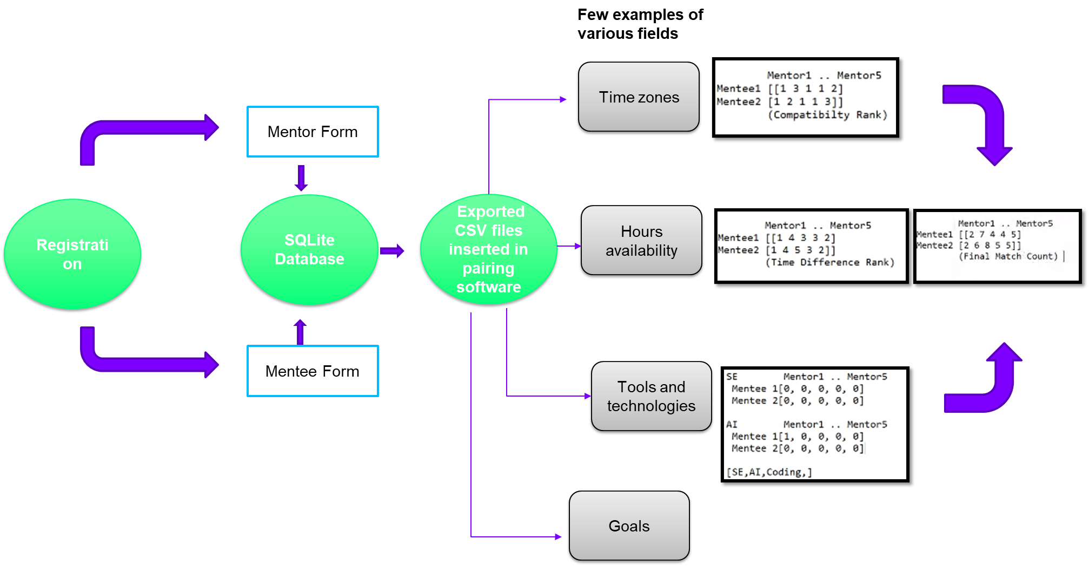
Approach
ALGORITHM

Slide 6
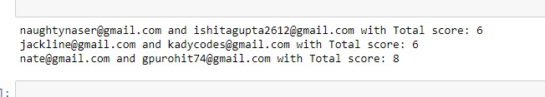
Output
Compatibility Score
Mentee
Mentor

Slide 7
Novelty of Solution
Pairing software is specifically designed in adherence with the need of the organization
The algorithms are designed from scratch
First support system for organizations automated work
One stop platform for girls in tech.

Slide 8
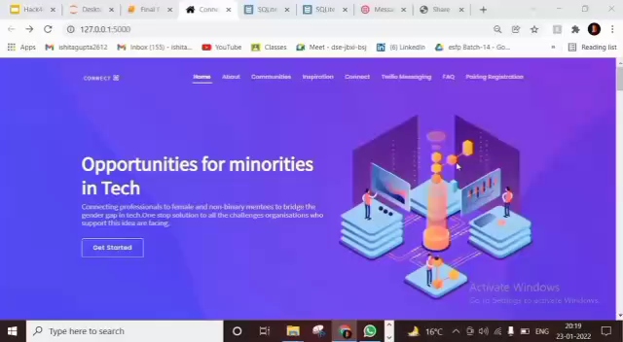
DEMO VIDEO (Working Prototype)
Insert your demonstration video here

Slide 9
Value Proposition
APPLICABILITY & BENEFITS
Connect has wide applicability in Women Mentoring Programmes like Command Tech, Girls Who Code, Girls in Tech which have lot of pairing to do and that to manually.
Gives girls in tech the ability to connect to professionals from the industry and widen their professional space.
Hassle free instant Whatsapp messaging. Can be used to text anyone without leaking their personal information.
9

Slide 10
Tools/Technologies Leveraged
Flask (Python Framework)
Twilio API (Instant Whatsapp Messaging)
HTML, CSS (For Web Application)
Sqlite (Database)
Python (for Algorithms)

Slide 11
Team
Ishita Gupta
Email:
ishitagupta2612@gmail.com
Geetanjali Purohit
Email:
gpurohit74@gmail.com

